Slide 1
Secure data hiding in images using Steganography
Presented By:
Pathapati Vasavi
CMR Engineering college – CSE(Cyber Security)

Slide 2
OUtLINE
Problem Statement
Technology used
Wow factor
End users
Result
Conclusion
Git-hub Link

Slide 3
Problem Statement
How can we send a message secretly to the destination.
Using steganography, information can be hidden in carriers such as in images, audio files, text files and videos.
This approach offers secure communication and ensures data protection even in case the carrier image is intercepted.
In this study, I proposed a new framework of an image steganography system to hide a digital text of a secret message.

Slide 4
Technology used
Python: The main programming language used.
AES Encryption: A secure method to encrypt the message so no one can read it without a key.
OpenCV: A powerful library for image processing and computer vision, used to manipulate and analyze images, and implement steganography techniques like DCT and LSB.
Steganography: Hiding the message inside an image by changing the least significant bits (LSB) of pixels.
Compression: Reducing the size of the data to hide, using libraries like zlib.
Password Protection: Ensures only authorized users can decrypt the hidden message.

Slide 5
Wow factors
This project stands out by combining encryption and steganography, offering double-layer security for hidden data. The data is embedded in the image using the LSB method, making it invisible to the naked eye. By selecting random pixels for embedding, it becomes harder to detect the hidden message. The message is also compressed to optimize space while maintaining the image's quality. Only authorized users with the correct password can decrypt the message, ensuring privacy. These features make it ideal for secure communication in sensitive areas like government, business, and personal privacy.

Slide 6
End users
Cybersecurity Professionals: For securing sensitive information.
Government Agencies: To protect classified data during transmission.
Financial Institutions: For secure sharing of financial data.
Media and Journalists: To securely share sensitive information and whistleblower data.
Healthcare Providers: To protect patient and medical data.
Private Individuals: For secure personal communication and file sharing.

Slide 7
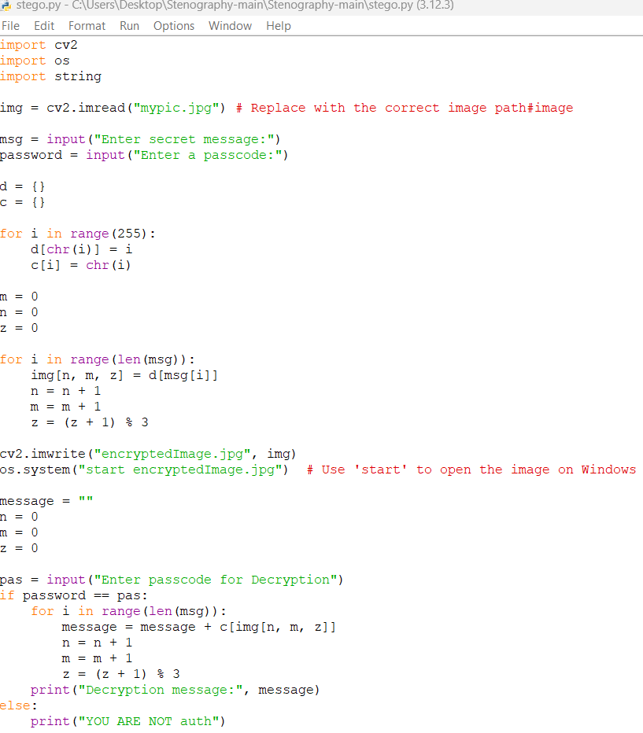
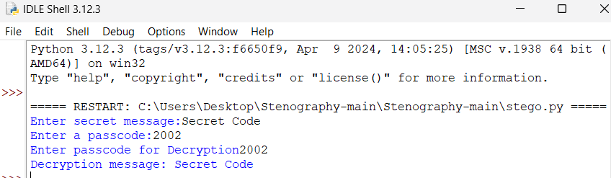
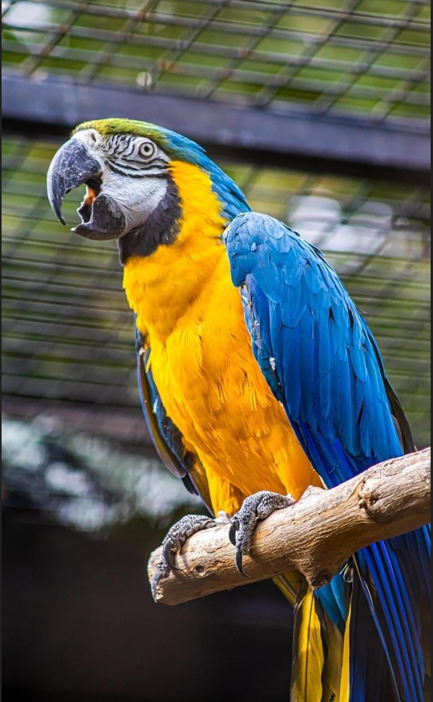
Results

Slide 8
Conclusion
In this project, we have successfully implemented a secure method for hiding data within images using steganography. This technique allows confidential information to be embedded in images without being visible to the human eye. By using advanced algorithms, we ensure the data remains safe and secure, making it difficult for unauthorized users to detect or alter it. This method offers a strong solution for applications that need privacy, like secure messaging and data sharing. As technology continues to improve, steganography can further strengthen the protection of sensitive data in digital formats.

Slide 9
GitHub Link
https://github.com/Vasavi1208/My-Aicteproject.git

Slide 10
THANK YOU

